Slide 1
Approximate
Solution
By: Ye Hun Joo and Josh Kuesters

Slide 2
Pseudo-code (greedy)
Read the input n and m
Make sure it is a complete graph
Initialize an empty graph as an adjacency matrix
For each edge in the input
Split it up into u, v, and w
If u isn’t already in the graph then add it as a key with an empty dictionary
Same with v
Add v and w as key-value pairs in the dictionary for u
Add u and w as key-value pairs in the dictionary for v
Call the nearest neighbor method

Slide 3
Pseudo-code cont. (greedy)
Call the nearest neighbor method
Set start vertex as the first key in the graph
Set current vertex as the start
Create a set of unvisited vertices and take out the starting vertex
Create a list
Get the closest vertex with the lowest weight and visit it
Remove from the unvisited set
Set current to the next vertex
Add start vertex to list to make a cycle
Get the length of the cycle and total weight
Return

Slide 4
Comparison

Slide 5
Runtime
The big O runtime in O(n^2), where n is the number of vertices
The main loop iterates over each vertex
For each vertex it iterates over all the neighbors
Therefore, each loop is O(n) which equals O(n^2)

Slide 6
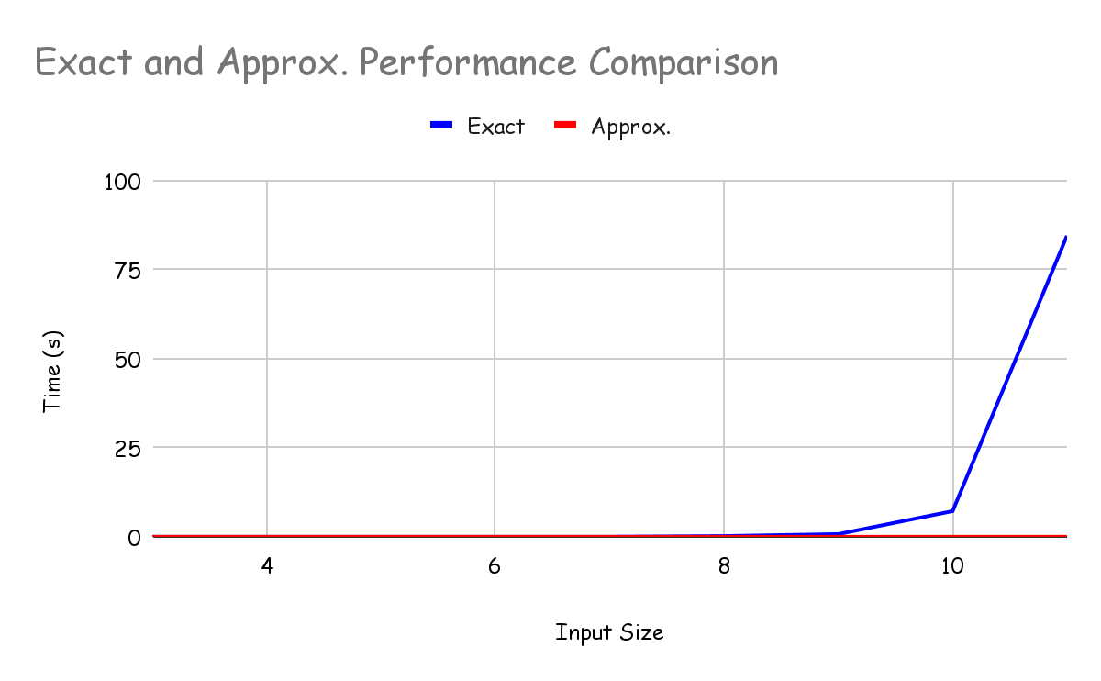
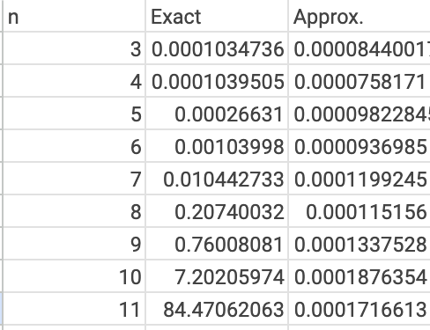
Performance Comparison

